Slide 1

Financial Modelling & Valuation of Reliance Industries
By
Saloni Jain

Slide 2
Objective
To analyze the financial performance of Reliance Industries.
To estimate its valuation using fundamental financial modeling techniques.
To assess its investment potential.

Slide 3
Table of Content
DATA SHEET
HISTORICAL FINANCIAL STATEMENTS
RATIO ANALYSIS
BETA ANALYSIS & RISK MEASUREMENT
WEIGHTED AVERAGE COST OF CAPITAL (WACC)
FORECASTING
FREE CASH FLOW TO FIRM (FCFF) & FINAL SHARE PRICE
INTRINSIC VALUATION
CONCLUSION

Slide 4
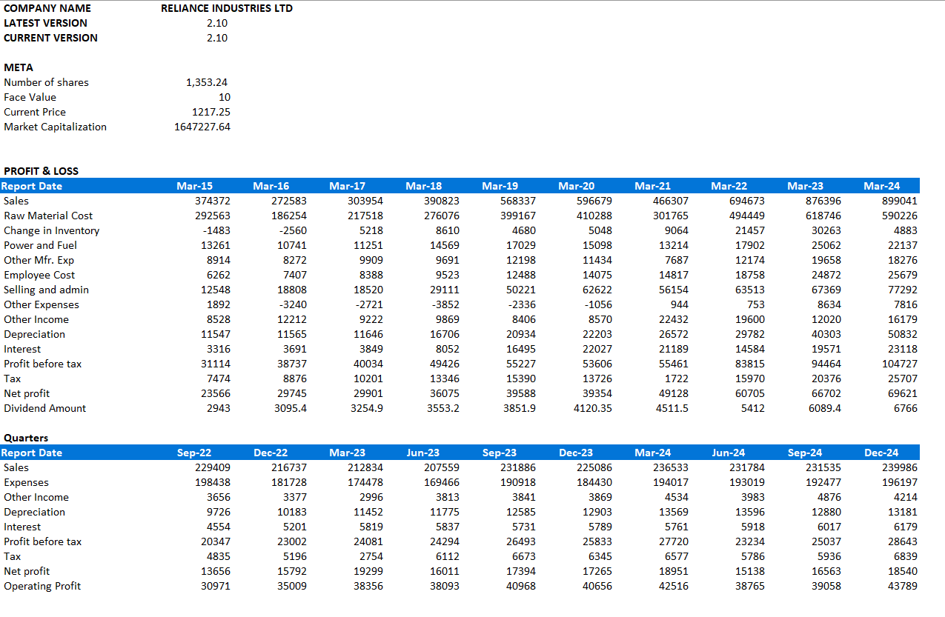
Data Sheet

Slide 5
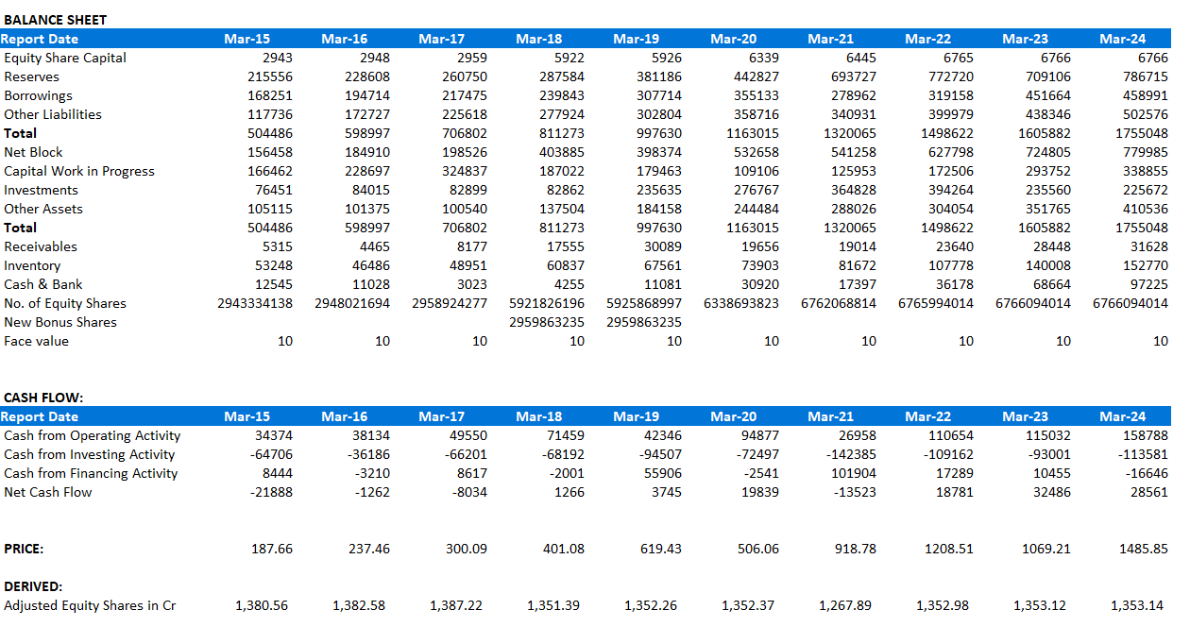
Data Sheet

Slide 6
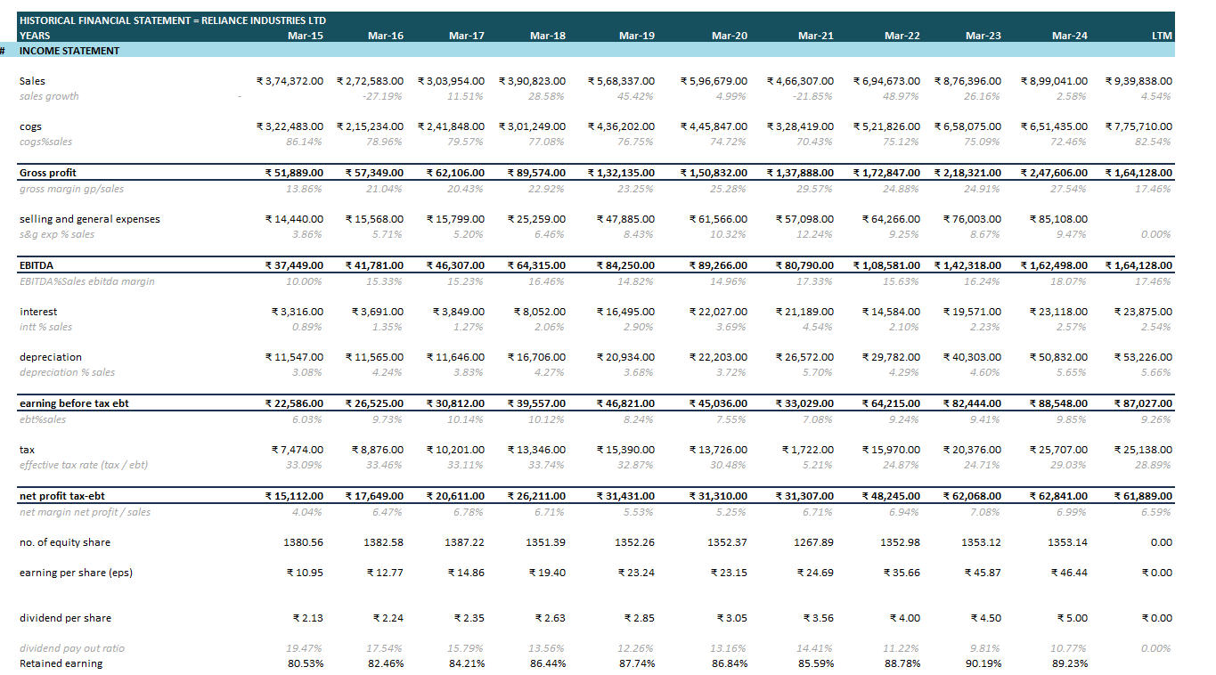
Historical Financial Statements
Sales Growth: Presented annual revenue growth trends.
EBITDA Trends: Evaluated earnings before interest, tax, depreciation, and amortization.
Profitability: Analyzed net income growth over the years.

Slide 7
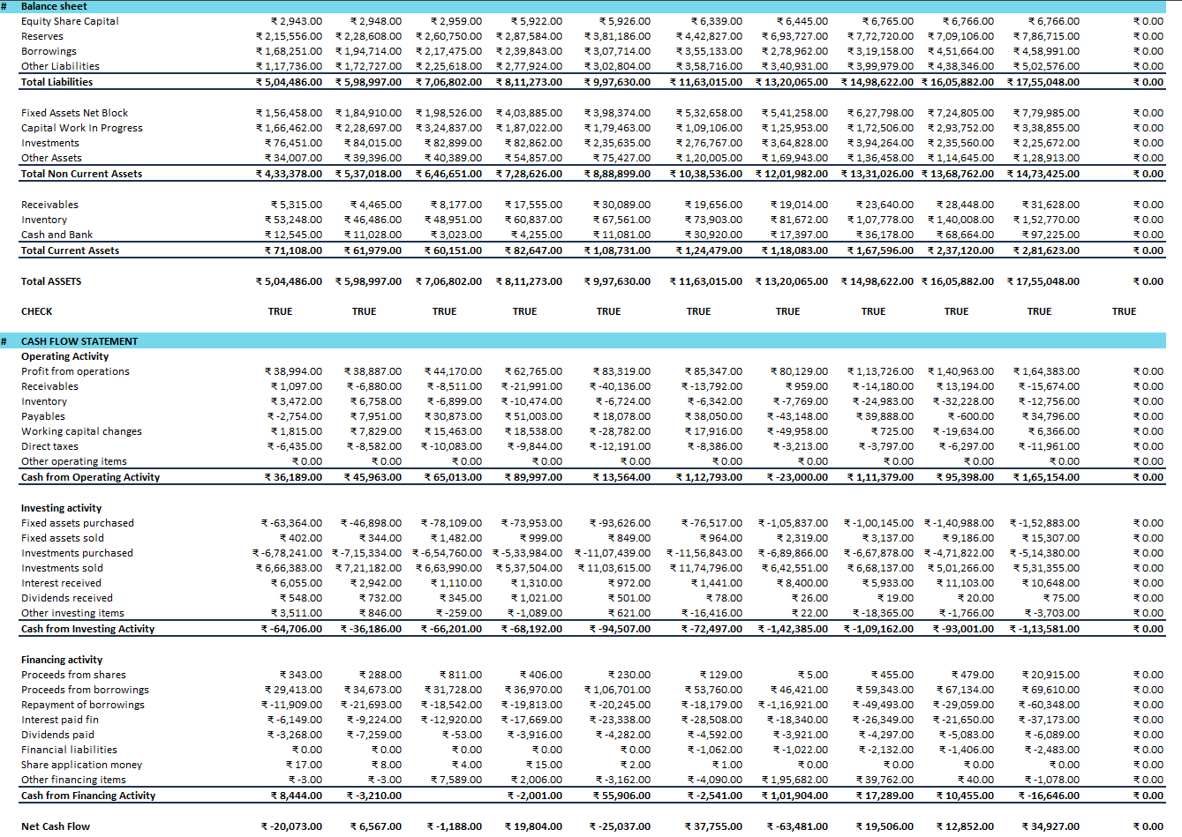
Historical Financial Statements

Slide 8

Ratio Analysis
Key Ratios Considered:
Revenue Growth
EBITDA Margin
Return on Equity (ROE)
Debt-to-Equity Ratio
Insights:
Strong sales growth in recent years.
Consistent profitability despite industry fluctuations.
Stable financial leverage.

Slide 9
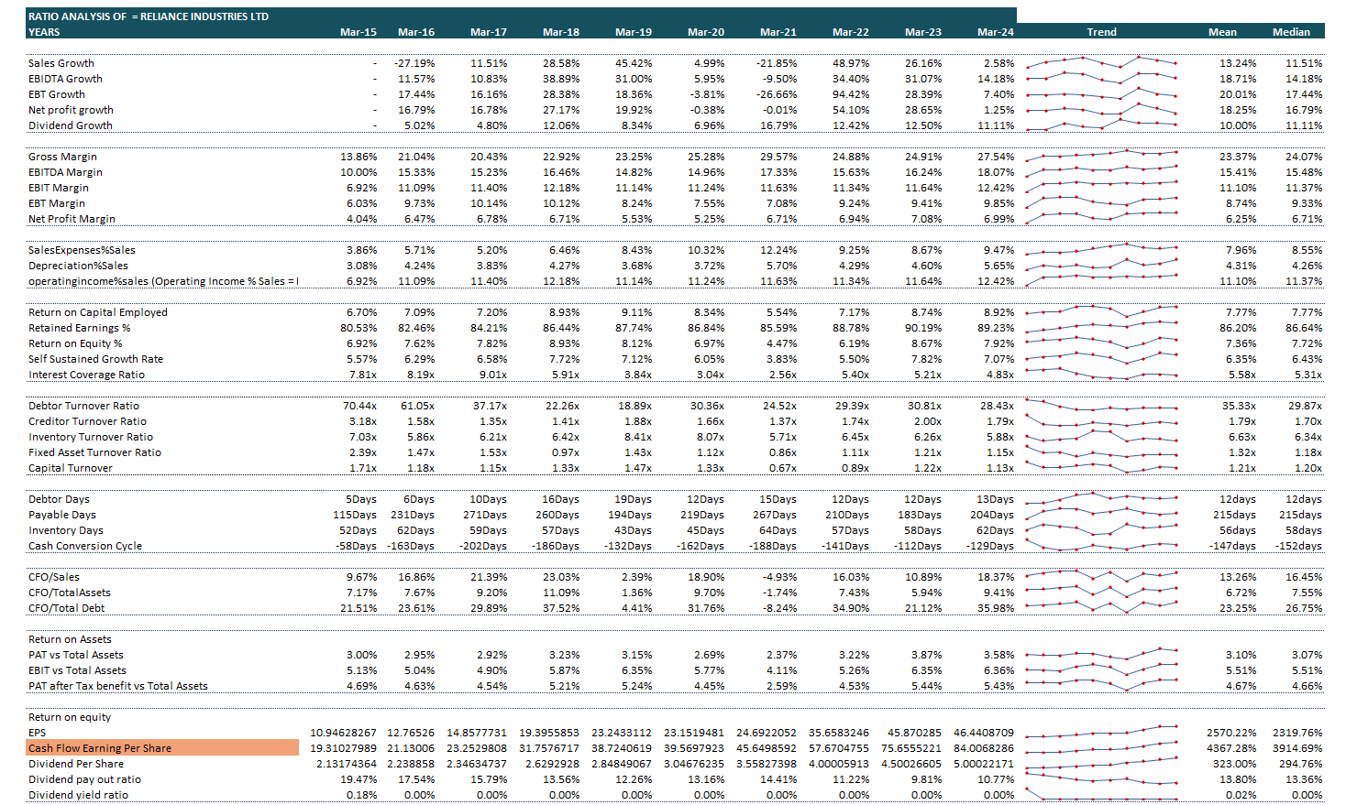
Ratio Analysis

Slide 10

Beta Analysis & Risk Management
Beta Calculation:
Used regression analysis of Reliance’s stock returns vs. market returns.
Compared with peer companies like IOCL, BPCL, HPCL, and MRPL.
Reliance Industries:
Levered Beta: 1.153
Unlevered Beta: 1.00
Implications: A beta of 1.153 indicates that Reliance’s stock is slightly more volatile than the market. This is expected for a company operating in cyclical industries like energy and petrochemicals. The unlevered beta of 1.00 reflects the company’s business risk without the impact of debt.

Slide 11
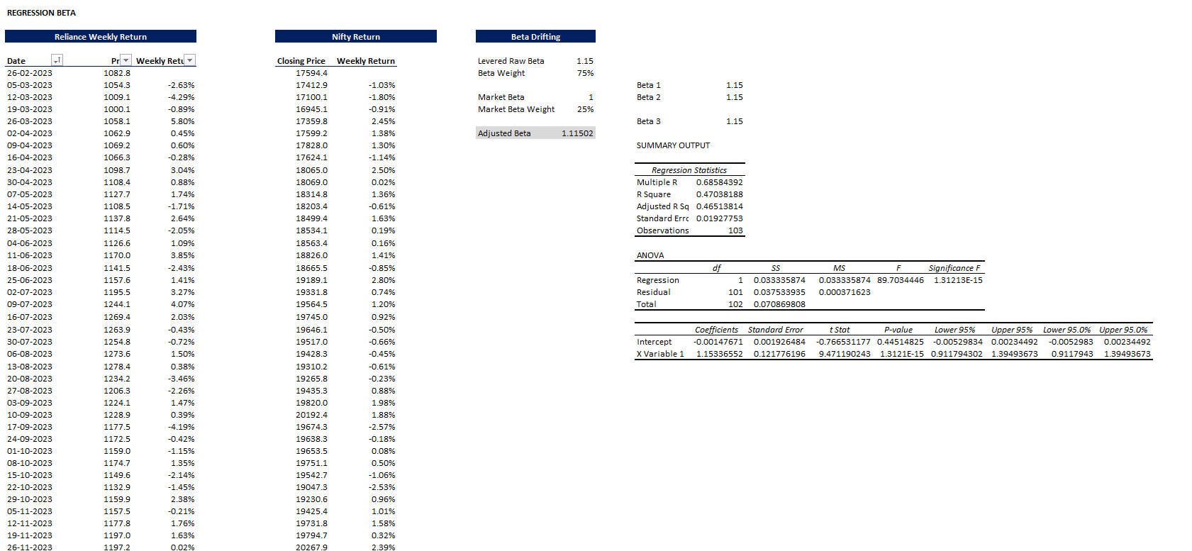
Beta Analysis & Risk Management

Slide 12
Weighted Average Cost Of Capital (WACC)
Components of WACC:
Cost of Equity (using CAPM)
Cost of Debt (using company financials)
Market Value Weights
Final WACC Estimate: 14.21%
WACC Calculation: The WACC for Reliance Industries is calculated to be 14.21%, which is a reasonable cost of capital for a large conglomerate. This indicates that Reliance needs to generate a return of at least 14.21 % on its investments to satisfy its investors.
Implications: A lower WACC is generally favorable as it reduces the hurdle rate for investment projects. Reliance’s WACC of 14.21 % suggests that the company can undertake projects with returns above this rate, which is achievable given its diversified business model and strong market position.

Slide 13
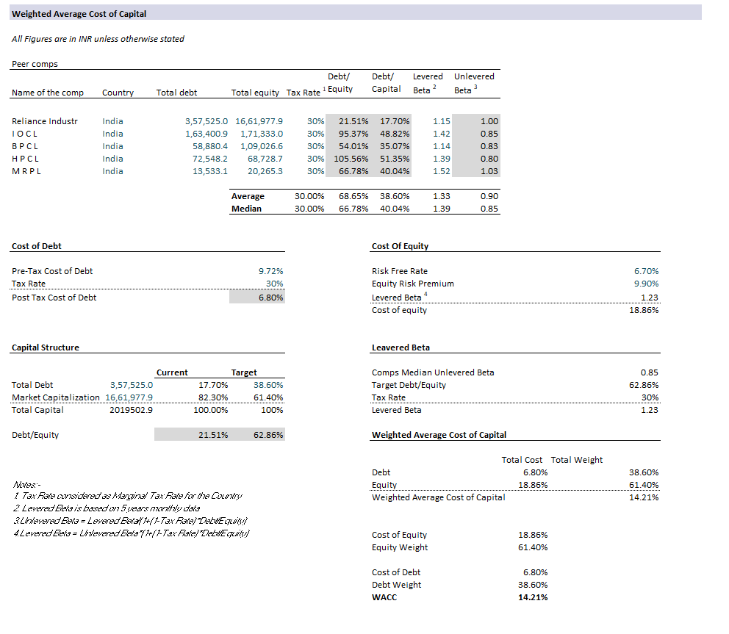
Weighted Average Cost Of Capital (WACC)
Comparison with Peers:
IOCL: Beta = 1.42 (higher volatility than Reliance).
BPCL: Beta = 1.14 (similar to Reliance).
HPCL: Beta = 1.39 (higher volatility than Reliance).
MRPL: Beta = 1.52 (highest volatility among peers).
Implications: Reliance’s beta is lower than most of its peers, indicating that it is less sensitive to market fluctuations. This makes Reliance a relatively safer investment compared to its peers, especially MRPL and HPCL.

Slide 14
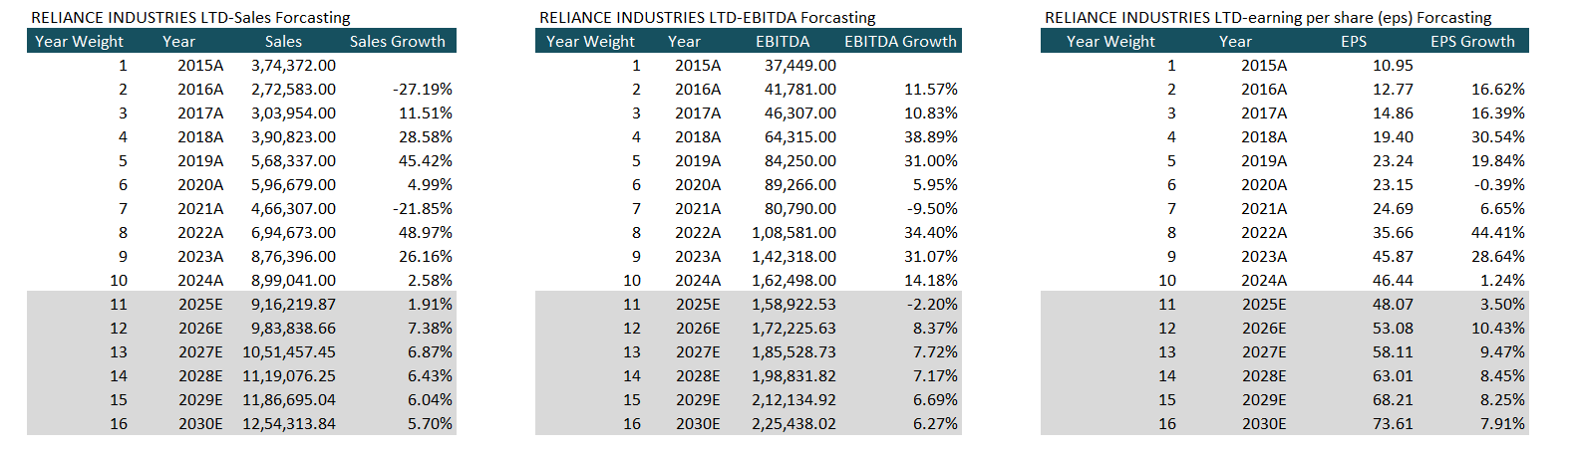
Forecasting
Projected Financials:
EBIT and tax rate adjustments
Future revenue and expense trends

Slide 15
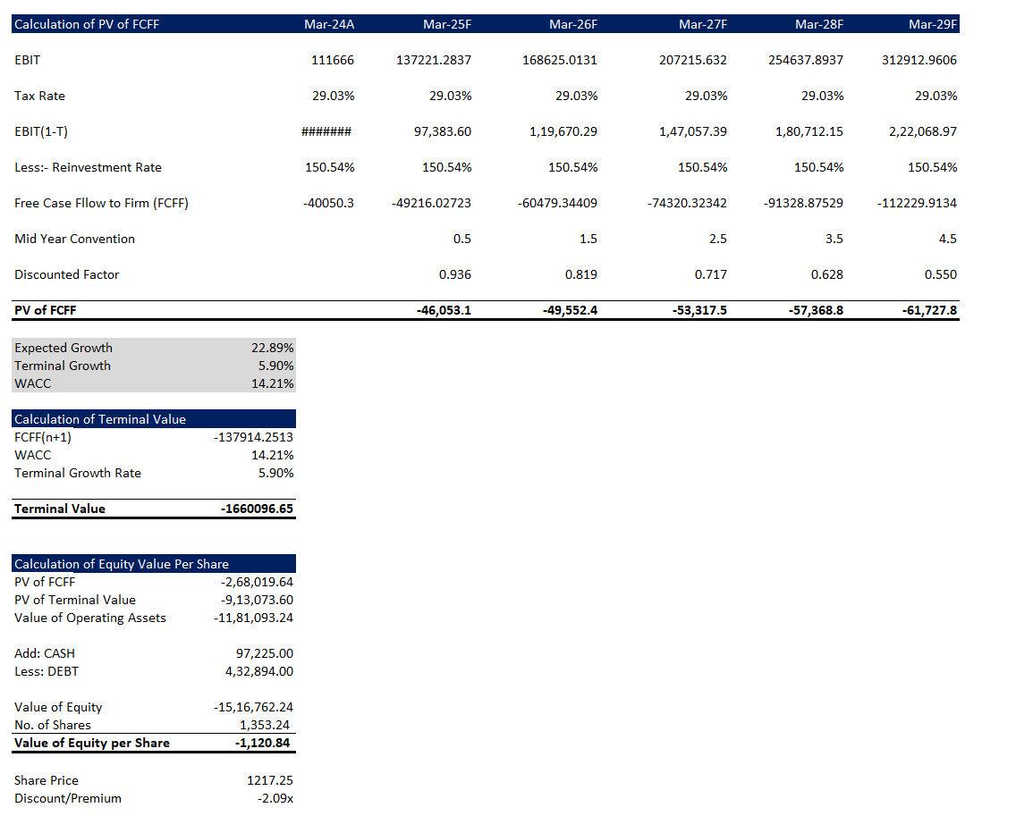
Free Cash Flow to Firm(FCFF) & Final Share Price
Discounting FCFF Using WACC:
1. Present Value of Free Cash Flows calculated.
2. Terminal value estimation.
Equity Value Per Share: 1120.84

Slide 16
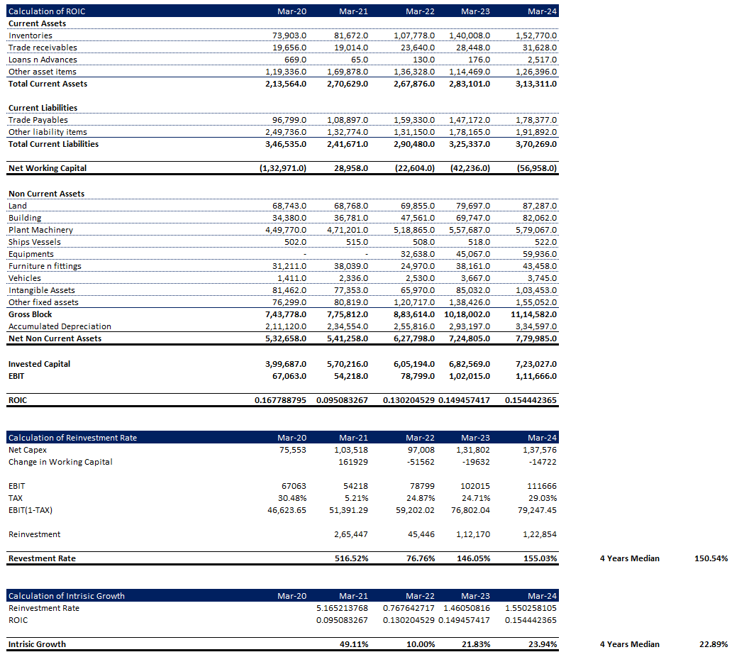
Intrinsic Growth

Slide 17
Conclusion
Reliance Industries is a financially strong company with a diversified business model, strong revenue growth, and improving profitability margins. Its WACC of 14.21% and moderate beta of 1.153 indicate a manageable cost of capital and market risk. Compared to its peers, Reliance is a safer and more attractive investment option.
Recommendation: Investors should consider Reliance Industries as a core holding in their portfolio, especially for long-term growth. For peers like IOCL and BPCL, a moderate allocation is recommended, while HPCL and MRPL are suitable for risk-tolerant investors.

Slide 18
Thank You

